Slide 1
SBA To Provide Economic Injury Disaster Loans
For Coronavirus Related Economic Disruptions

Slide 2
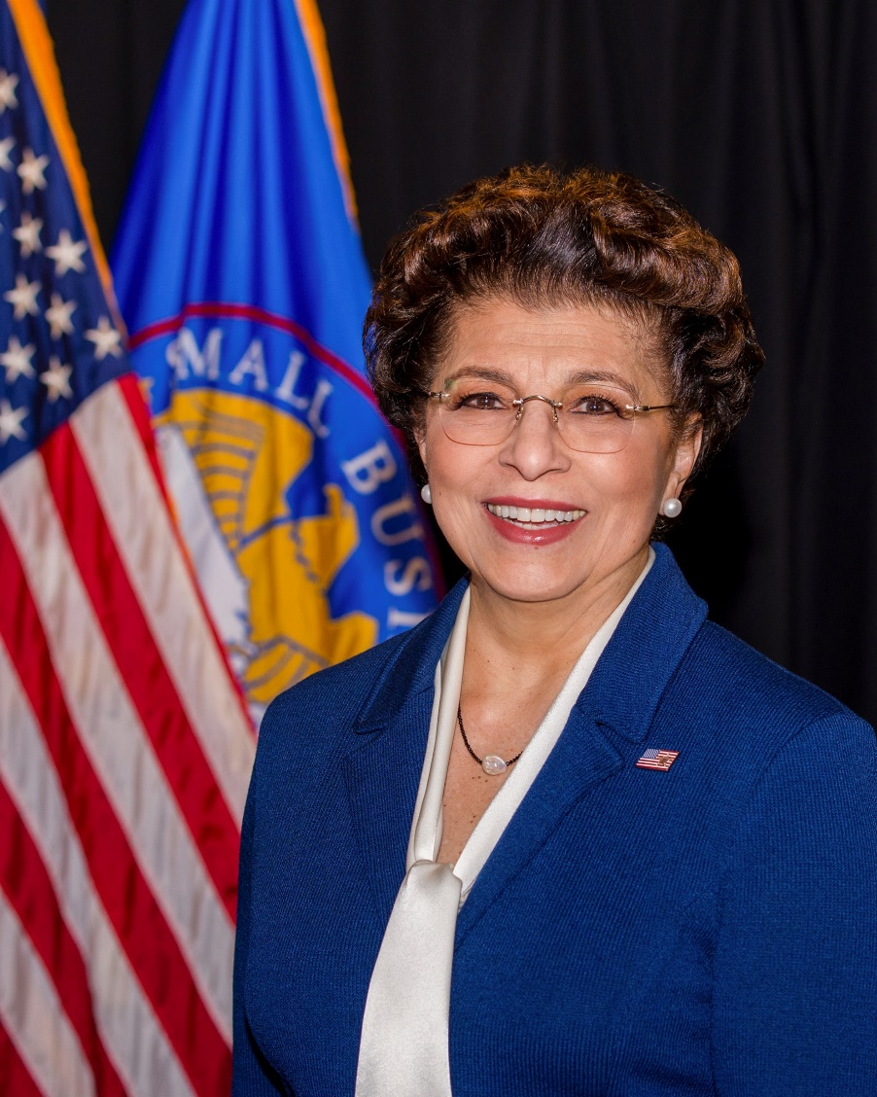
SBA’s Disaster Declaration Makes Loans Available Due to the Coronavirus (COVID-19)
The U.S. Small Business Administration (SBA) is offering designated states and territories low-interest federal disaster loans for working capital to small businesses suffering substantial economic injury as a result of the Coronavirus (COVID-19).
Upon a request received from a state’s or territory’s Governor, SBA will issue under its own authority, as provide by the Coronavirus Preparedness and Response Supplement Appropriations Act that was recently signed by the President, an Economic Injury Disaster Loan declaration.
Administrator Jovita Carranza

Slide 3
SBA’s Economic Injury Disaster Loan Basics
What businesses are eligible to apply?
SBA’s Economic Injury Disaster Loans (or working capital loans) are available to small businesses, small agricultural cooperatives, small aquaculture businesses and most private non-profit organizations
This includes:
Businesses directly affected by the disaster
Businesses that offer services directly related to the businesses in the declaration
Other businesses indirectly related the industry that are likely to be harmed by losses in their community
(Example: Manufacturer of widgets may be eligible as well as the wholesaler and retailer of the product.
3

Slide 4


SBA’s Economic Injury Disaster Loan Basics
What is the criteria for a loan approval?
Credit History-Applicants must have a credit history acceptable to SBA.
Repayment –SBA must determine that the applicant business has the ability to repay the SBA loan.
Eligibility- The applicant business must be physically located in a declared county and suffered working capital losses due to the declared disaster, not due to a downturn in the economy or other reasons.

Slide 5
SBA’s Economic Injury Disaster Loan Terms
How much can I borrow?
Eligible entities may qualify for loans up to $2 million.
The interest rates for this disaster are 3.75 percent for small businesses and
2.75 percent for nonprofit organizations with terms up to 30 years.
Eligibility for these working capital loans are based on the size (must be a small business) and type of business and its financial resources.
How can I use the loan funds?
These working capital loans may be used to pay fixed debts, payroll, accounts payable, and other bills that could have been paid had the disaster not occurred. The loans are not intended to replace lost sales or profits or for expansion.

Slide 6

Economic Injury Disaster Loan Terms
What are the collateral requirements?
  Economic Injury Disaster Loans over $25,000 require collateral.
  SBA takes real estate as collateral when it is available.
  SBA will not decline a loan for lack of collateral,
  but requires borrowers to pledge what is available.
6

Slide 7

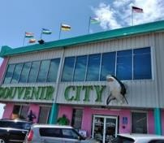

SBA’s Economic Injury Disaster Loan Basics
What kinds of small businesses can apply?
Examples of eligible industries include but are not limited to the following: hotels, recreational facilities, charter boats, manufactures, sports vendors, owners of rental property, restaurants, retailers, souvenir shops, travel agencies, and wholesalers.
What other criteria is involved?
The applicant business must have a physical presence in the declared disaster area. An applicant’s economic presence alone in a declared area does not meet this requirement. The physical presence must be tangible and significant. Merely having a P.O. Box in the disaster area would not qualify as a physical presence.
7

Slide 8
SBA’s Working Capital Loans are Different from Other SBA Loans
SBA’s Economic Injury Disaster Loan (EIDLs) funds come directly from the U.S. Treasury.
Applicants do not go through a bank to apply. Instead apply directly to SBA’s Disaster Assistance Program at: DisasterLoan.sba.gov
There is no cost to apply.
There is no obligation to take the loan if offered.
The maximum unsecured loan amount is $25,000.
Applicants can have an existing SBA Disaster Loan and still qualify for an EIDL for this disaster, but the loans cannot be consolidated.

Slide 9
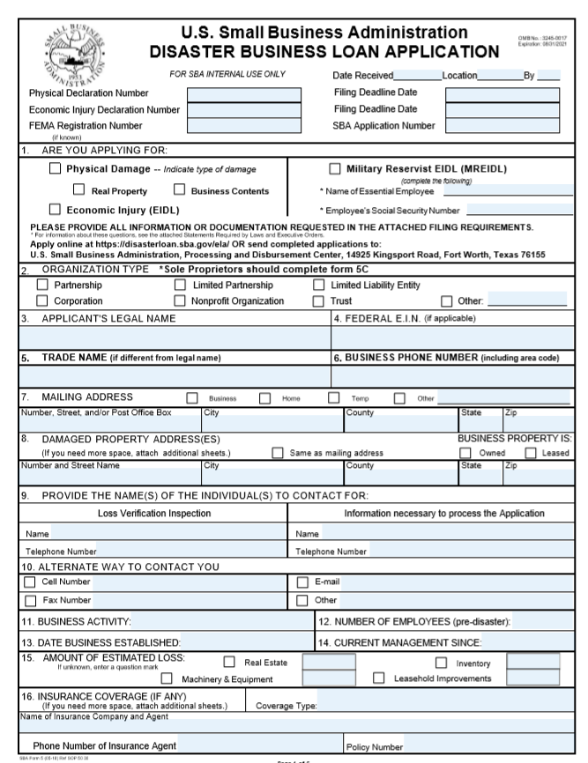
Basic Filing Requirements
Completed SBA loan application (SBA Form 5).
Tax Information Authorization (IRS Form 4506T)
for the applicant, principals and affiliates.
Complete copies of the most recent Federal Income Tax Return.
Schedule of Liabilities (SBA Form 2202).
Personal Financial Statement (SBA Form 413).
Other Information may also be requested.
*Although a paper application and forms are acceptable, filing electronically is easier, faster and more accurate.
9

Slide 10
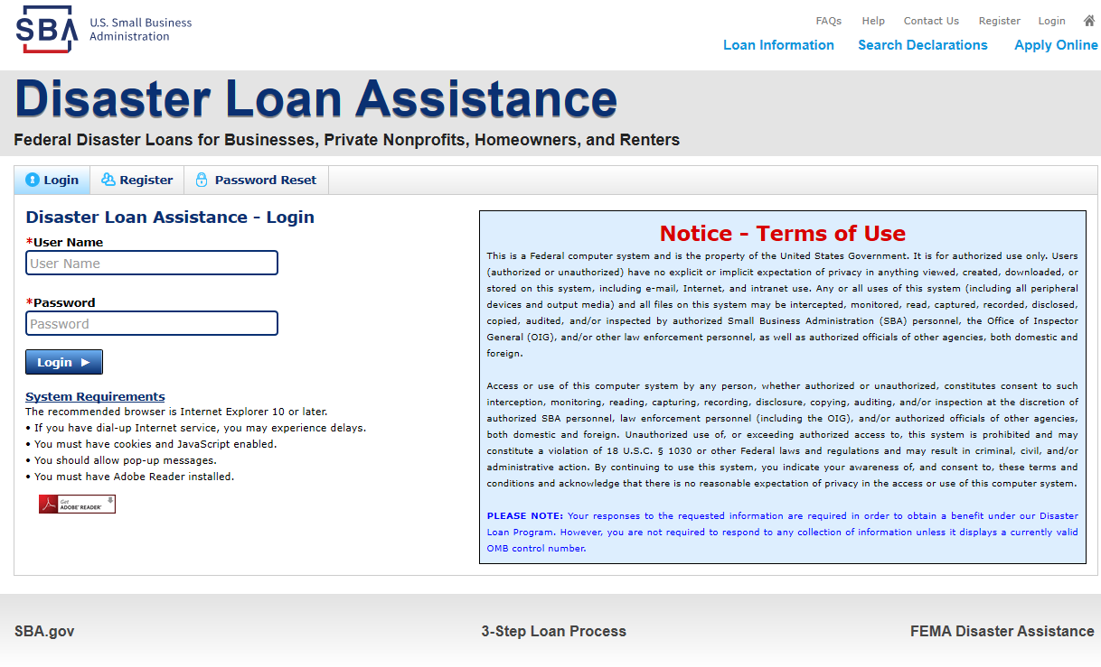
Additional Filing Requirements
Other information that may be requested:
Complete copy, including all schedules, of the most recent Federal income tax return for principals, general partners or managing member, and affiliates (see filing requirements for more information).
If the most recent Federal income tax return has not been filed, a year-end profit-and-loss statement and balance sheet for that tax year .
A current year-to-date profit-and-loss statement .
Additional Filing Requirements (SBA Form 1368) providing monthly sales figures. (This is especially important for Economic Injury Disaster Loans.)
10

Slide 11
Ineligible Entities
What are some of the businesses that are ineligible for an Economic Injury Disaster Loan?
Agricultural Enterprises -If the primary activity of the business (including its affiliates) is as defined in Section 18(b)(1) of the Small Business Act, neither the business nor its affiliates are eligible for EIDL assistance.
Religious Organizations
Charitable Organizations
Gambling Concerns (Ex: Concerns that derive more that 1/3 of their annual gross revenue from legal gambling activities)
Casinos & Racetracks (Ex: Businesses whose purpose for being is gambling (e.g., casinos, racetracks, poker parlors, etc.) are not eligible for EIDL assistance regardless of 1/3 criteria above.
11

Slide 12
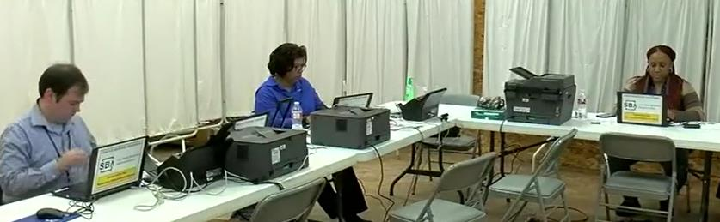
How to Apply
SBA’s Customer Service Representatives are ready to serve.
Applicants may apply online using the Electronic Loan Application (ELA) via SBA’s secure website at https://disasterloan.sba.gov/ela.
Paper loan applications can be downloaded from www.sba.gov/disaster. Completed applications should be mailed to: U.S. Small Business Administration, Processing and Disbursement Center, 14925 Kingsport Road, Fort Worth, TX 76155.
Disaster loan information and application forms may also be obtained by calling the SBA’s Customer Service Center at 800-659-2955
(800-877-8339 for the deaf and hard-of-hearing) or by sending an email to disastercustomerservice@sba.gov.

Slide 13
Assistance From SBA Partners
Free assistance with reconstructing financial records, preparing financial statements and submitting the loan application is available from any of SBA’s partners: Small Business Development Centers (SBDCs), SCORE, Women’s Business Centers (WBC), and Veteran’s Business Outreach Centers and local Chambers of Commerce.
For the nearest office, visit: https://www.sba.gov/local-assistance

Slide 14
Submit Your Application
As Soon As Possible
Recheck the filing requirements to ensure that all the needed information is submitted.
The biggest reason for delays in processing is due to missing information. Make sure to complete all filing requirements before submitting the application and forms.
If more funds are needed, applicants can submit supporting documents and a request for an increase. If less funds are needed, applicants can request a reduction in the loan amount.
If the loan request is denied, the applicant will be given up to six months in which to provide new information and submit a written request for reconsideration.

Slide 15

Any Questions?
More information concerning
SBA and its programs
visit our website at:
www.sba.gov/disaster

Slide 16
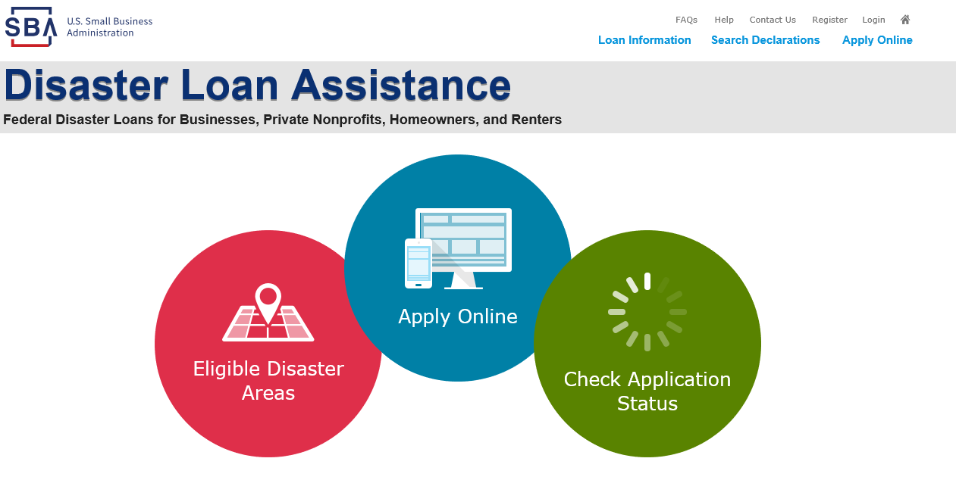
Disaster Loan Application Portal (DLAP)

Slide 17
Disaster Loan Application Portal
This presentation will provide guidance on how to complete an Electronic Business Application utilizing SBA Form 5 and SBA Form 5C. Before starting this process, please insure you have the filing requirements as defined in this document. These documents are required for processing and EIDL application.

Slide 18
Filing Requirements
Electronic Loan Application (Form 5)
Electronic Loan Application (Form 5C) Sole Proprietorship Only
Tax Authorization (Form 4506-T) 20% Owners/GP/50% Affiliate
Most recent Business Tax Return
Personal Financial Statement (Form 413) 20% Owners/GP
Schedule of Liabilities (Form 2202)

Slide 19
Disaster Loan Application Portal (DLAP)
DOUBLE-CLICK ON THE LINK TO ACCESS THE SITE
https://disasterloan.sba.gov/ela/
DOUBLE-CLICK APPLY ONLINE

Slide 20
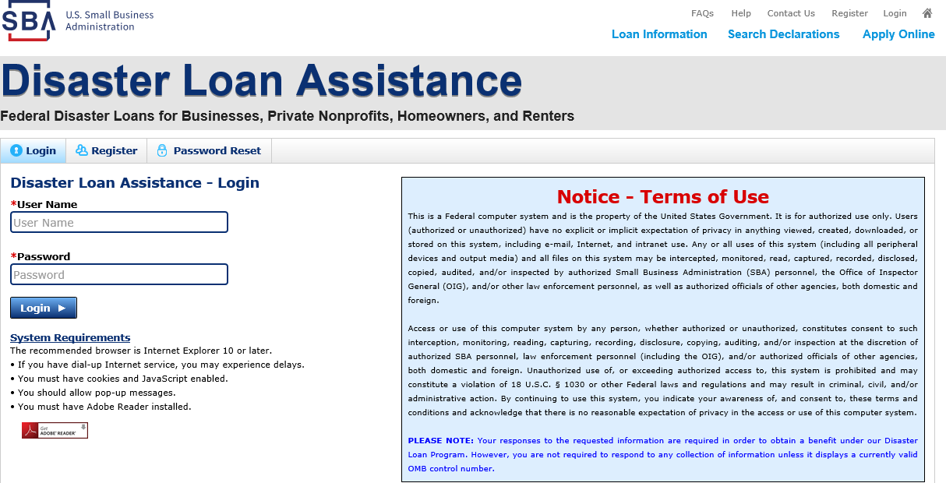
Register
From this page you can:
1) Begin a new application by clicking on Register
2) Return to complete a started application by inputting a user name and password

Slide 21
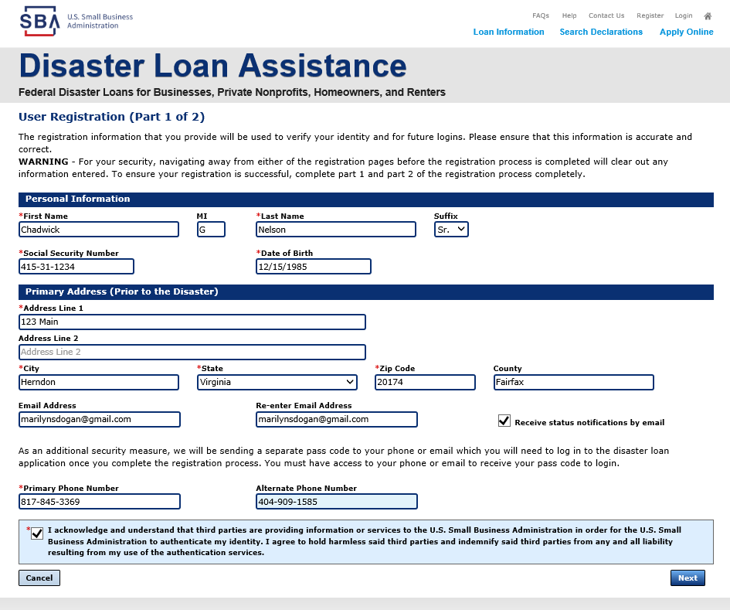
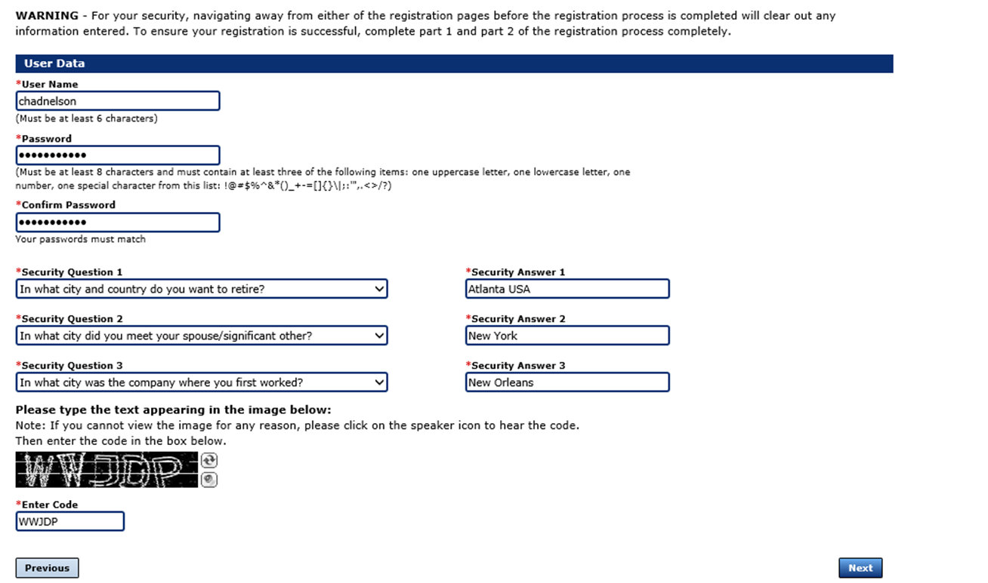
Complete Registration Information
On page 1 of the registration, pay close attention to the sections with an * these sections must be completed. It is important that a good email address and cell phone number are supplied.
On page 2 of the registration you will create your unique user-name and password. When creating your security questions, make sure to use information you won’t likely forget. If your password ever requires a reset, you would need this information
To advance to the next page, go next

Slide 22
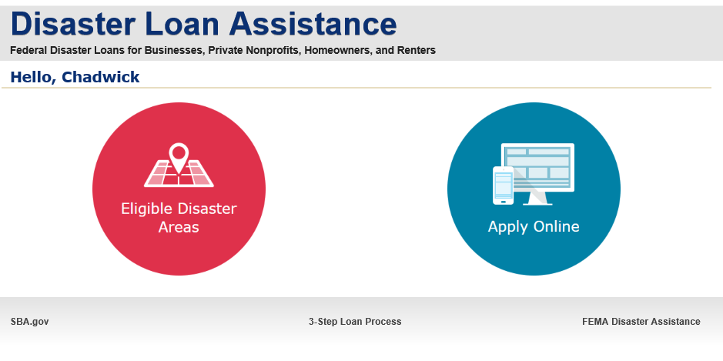
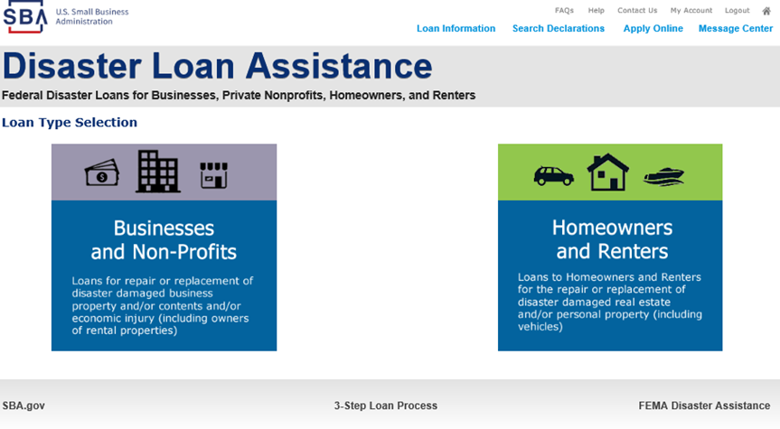

Apply Online
Double Click on “Apply Online”
Double Click on Business and Non Profit

Slide 23
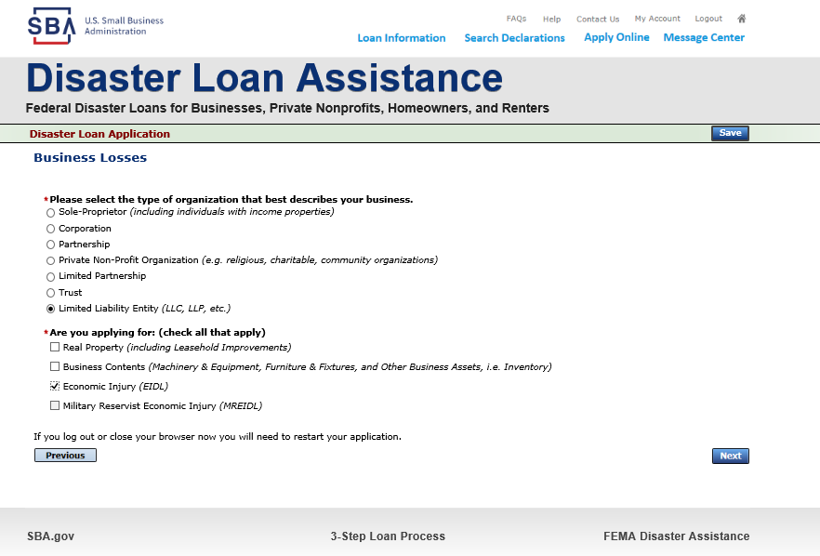
Business Type
SBA Form 5 would be completed by:
Corporations
Partnership
Private Non-Profit Organizations
Limited Partnership
Trust
Limited Liability Entity
SBA Form 5C would be completed by:
Sole Proprietorship
Once you make your selection the system will automatically direct you to the form.

Slide 24
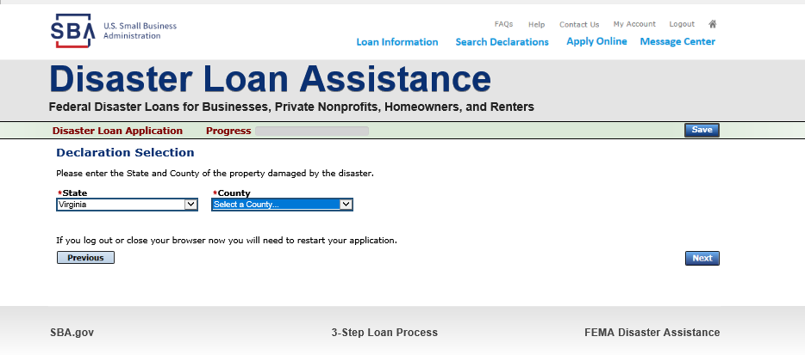
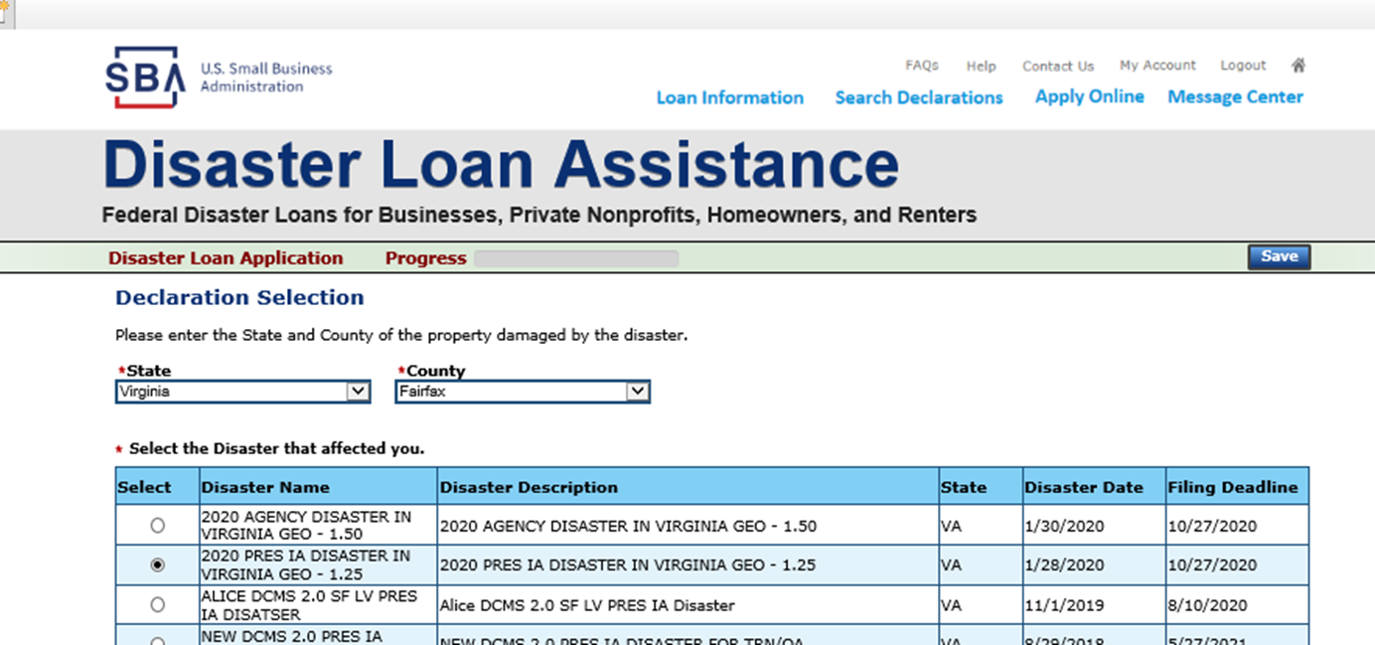
Select State /County / Disaster Declaration
Use the drop-down box and select the State and County where the loss has happened
Select the disaster declaration

Slide 25
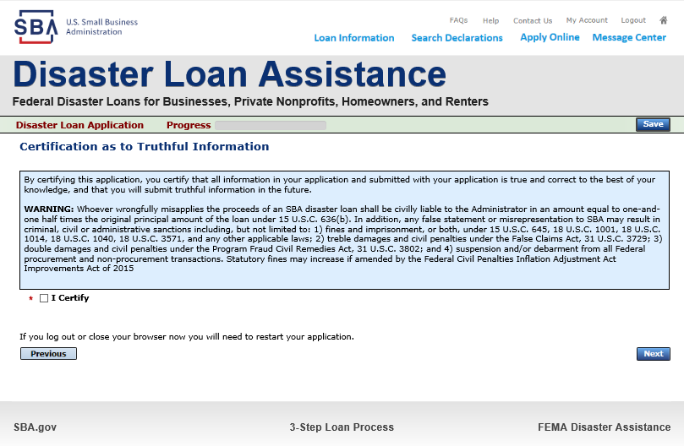
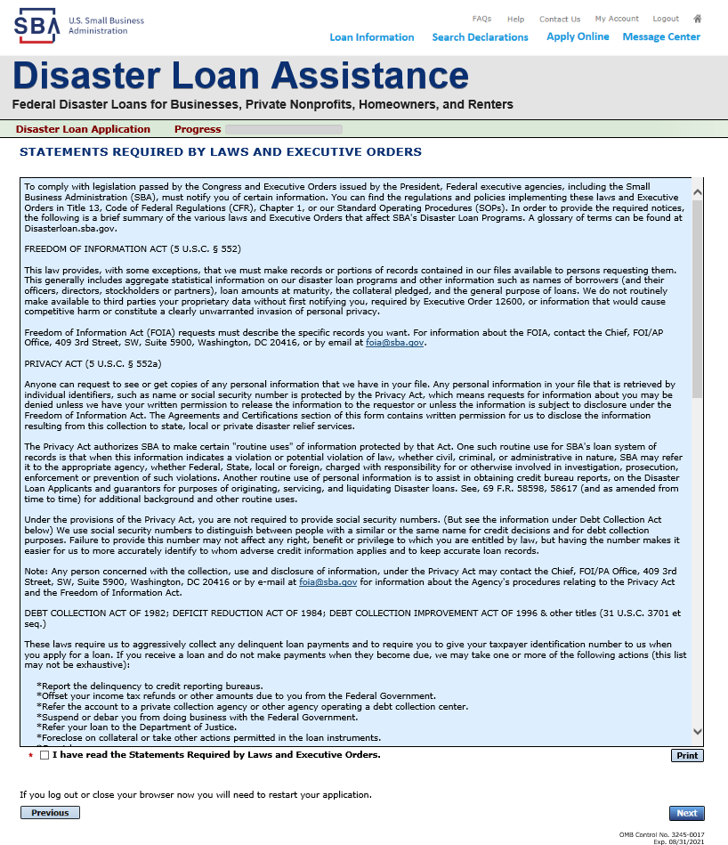
Complete Certifications
Read and Electronically Agree to the Certification of Truthful Information and the Executive Orders Document.

Slide 26
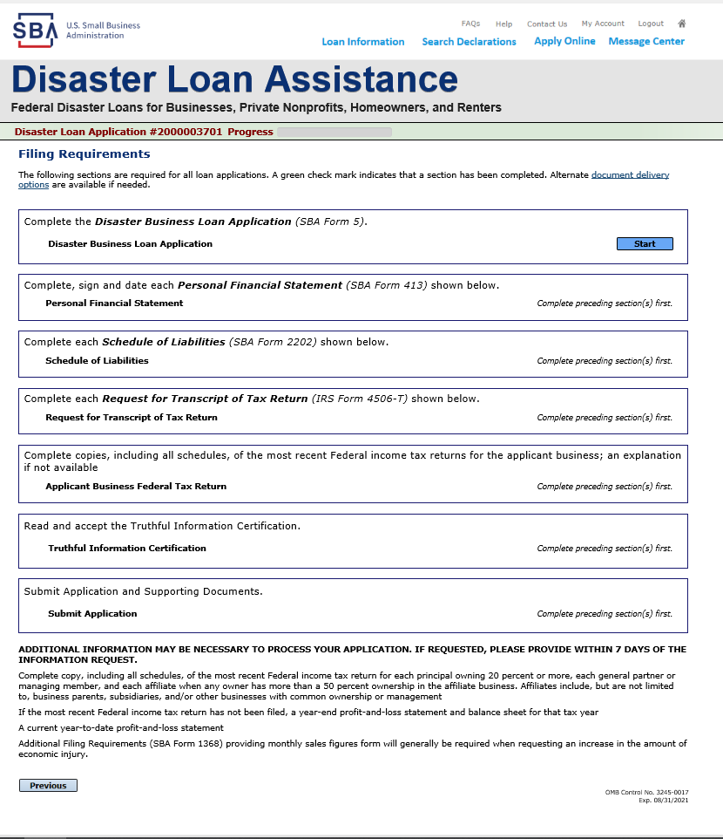
Start Application – Form 5
This business type for this example is an LLC.
This page provides information on all the filing requirements necessary to have a successfully completed application.
To begin depress START

Slide 27
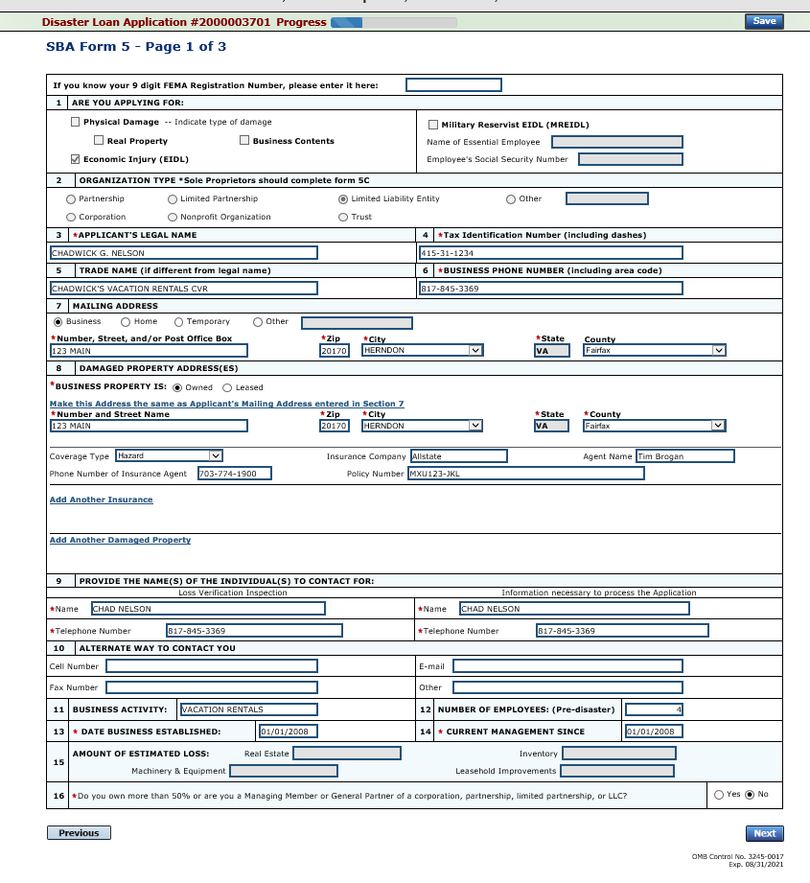
Form 5 – Page 1
Fill in the information on this page as necessary, items with a red * are mandatory field and you will not be able to advance to NEXT until these sections are completed.

Slide 28
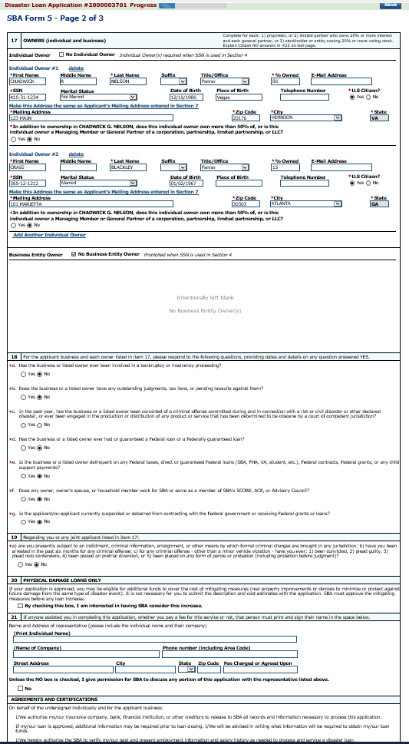
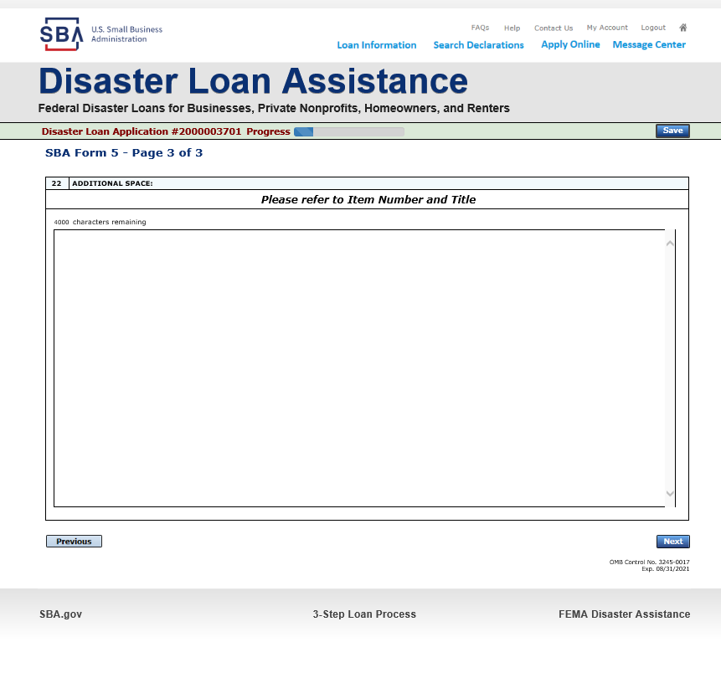
Form 5 – Pages 2 and 3
Page 3 is used for any relevant comments
Page 2 of Form 5 allows the business owner to provide information about any Partners or Affiliate Businesses.
Note: If a business is a partnership all members must listed with the % of ownership until the combined entries equal 100%

Slide 29
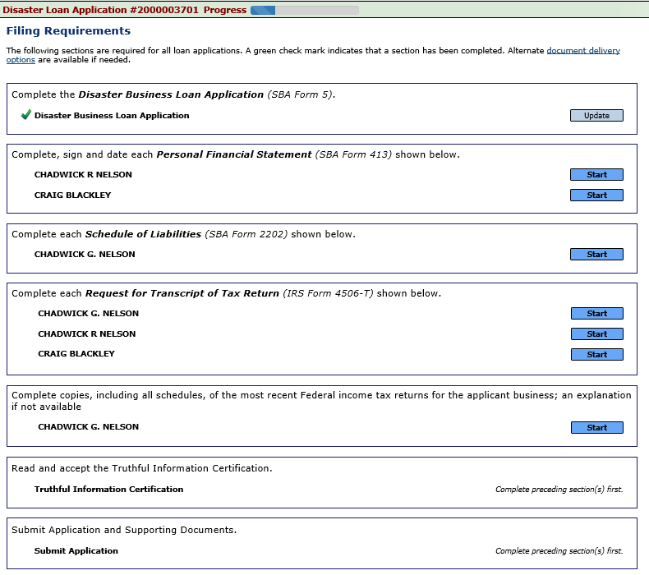
Filing Requirements
Now that the application is complete, the filing requirements on this page must be submitted / uploaded to complete the process.

Slide 30

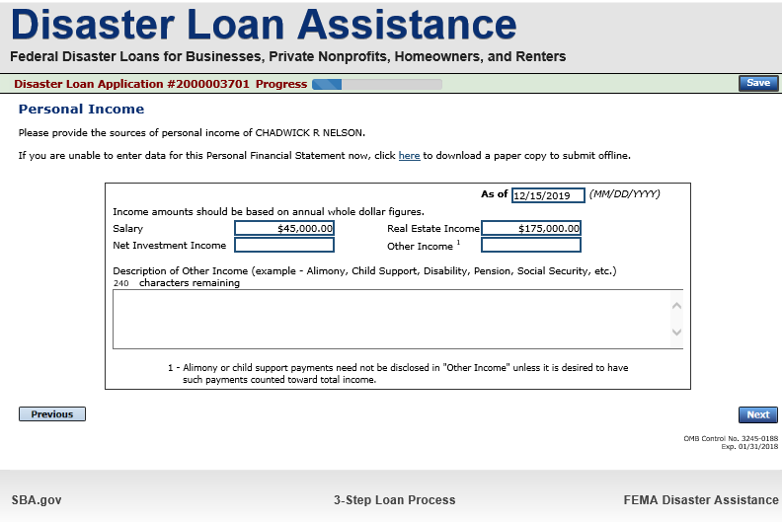
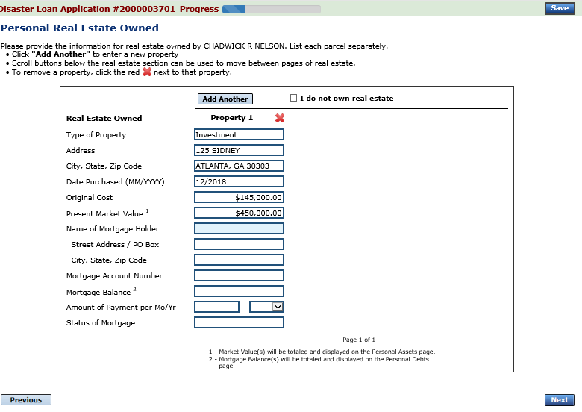
Personal Financial Statement
You can use this form to complete your personal financial statement or upload a financial statement you already have by scanning and uploading that document
If you indicated you have real estate you must complete this form, supplying additional information

Slide 31
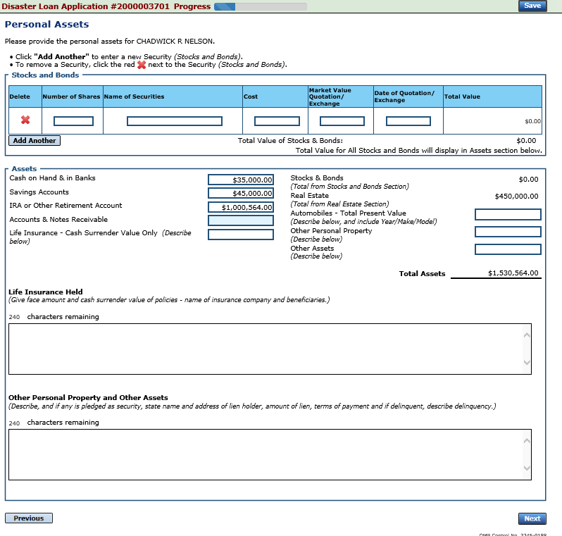
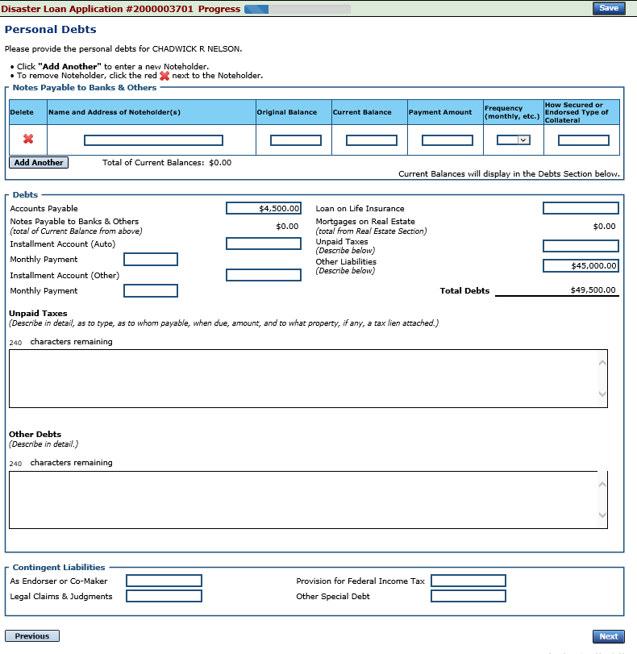
Personal Assets / Debits
The applicant and any partner would need to provide information on assets and debits

Slide 32

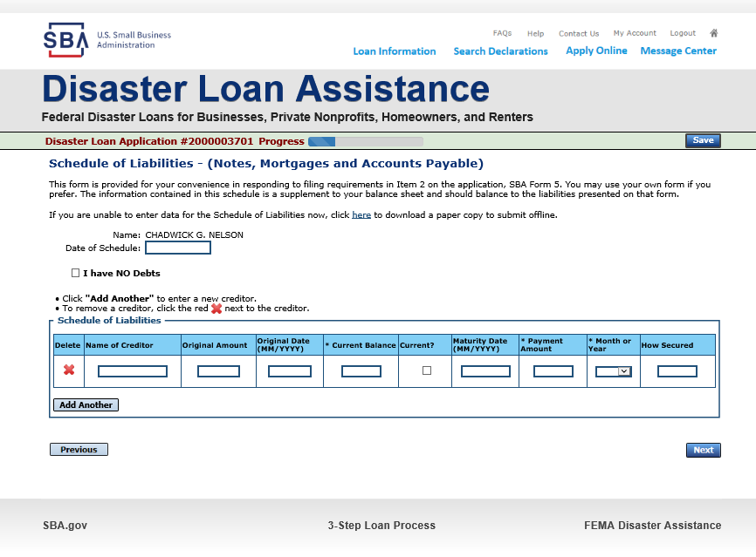
Schedule of Liabilities – SBA form 2202
Applicant would click on Schedule of Liabilities and either complete the SBA form or upload the applicant’s document

Slide 33
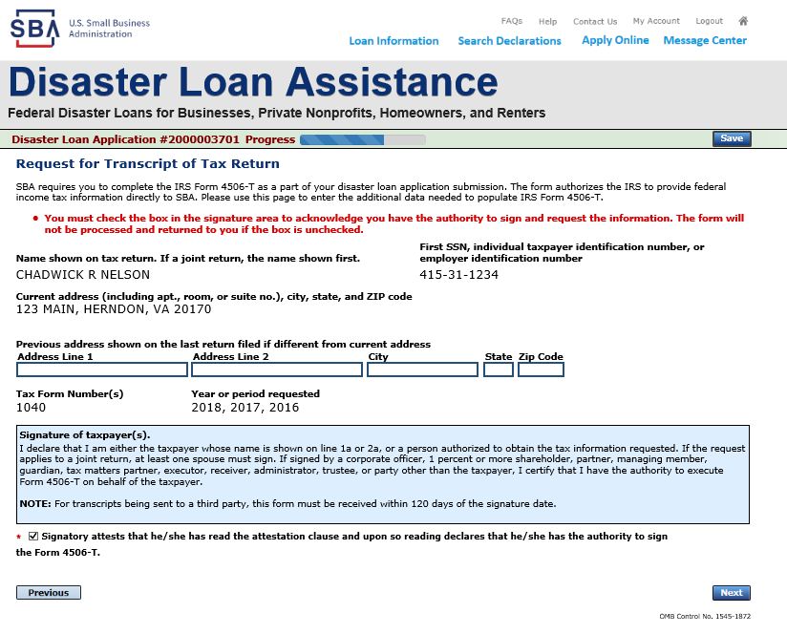
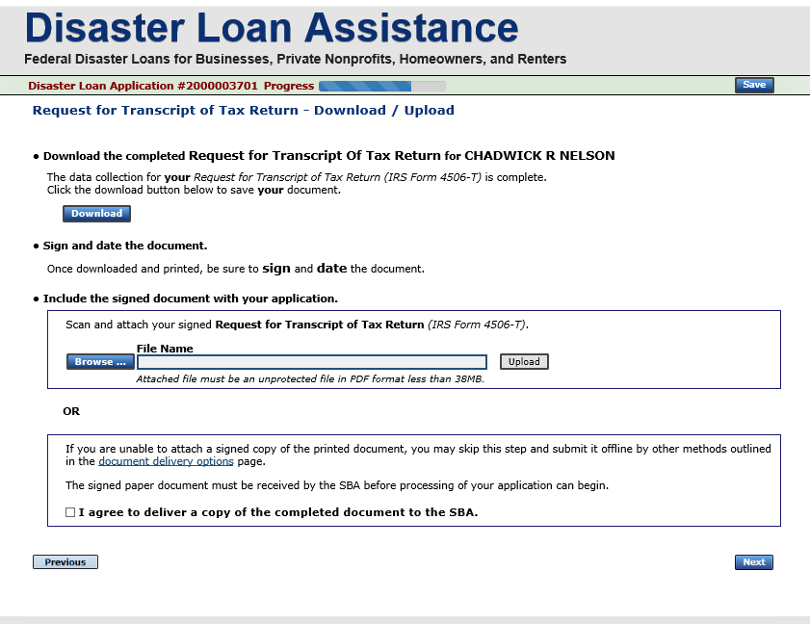
Uploaded 4506T
The 4506T can be uploaded once the form is printed and signed. You would need to save a copy on your desktop, once saved browse find the document and upload.
You could also opt to deliver offline

Slide 34
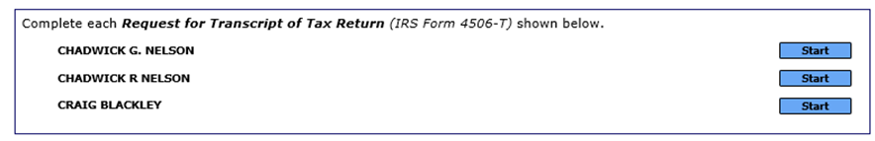
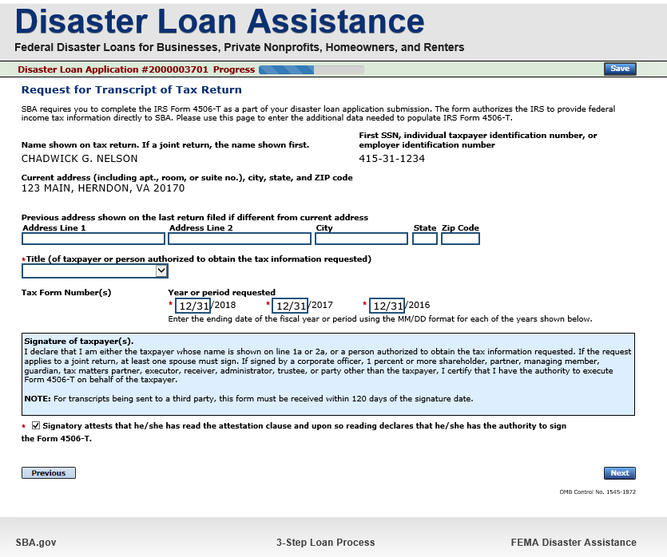
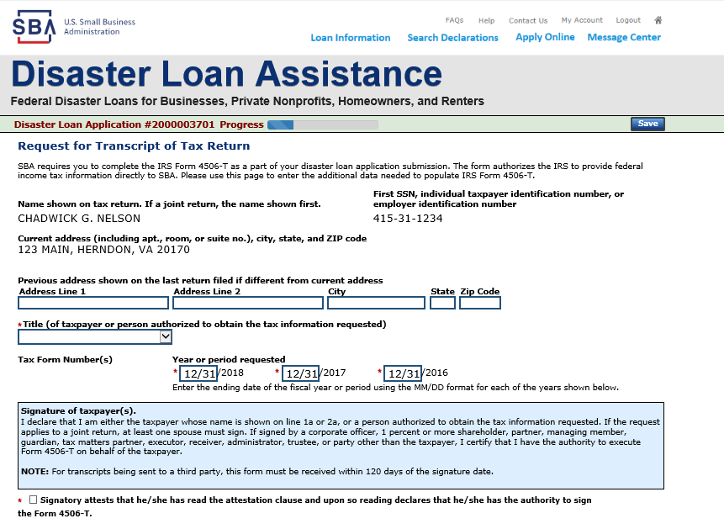
Electronically file 4506T
Each Applicant and Partner must submit a 4506T

Slide 35
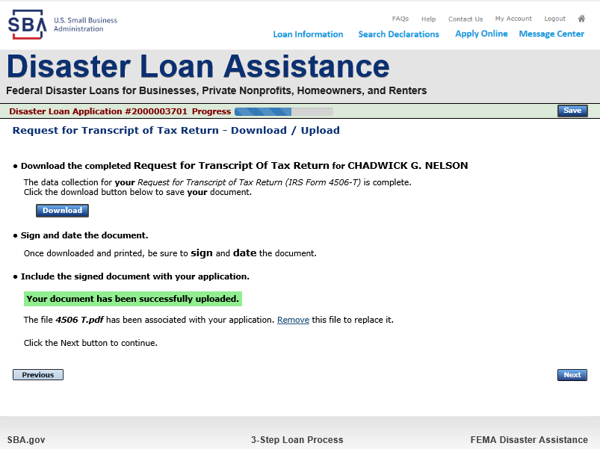
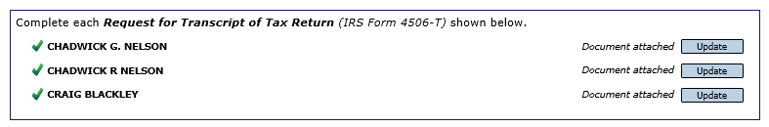
4506T Uploaded Successful
Once the 4506 T is uploaded you will receive a message back indicating the transmittal was successful. Make sure all fields are complete. All partners must submit this form for their individual and business taxes.

Slide 36

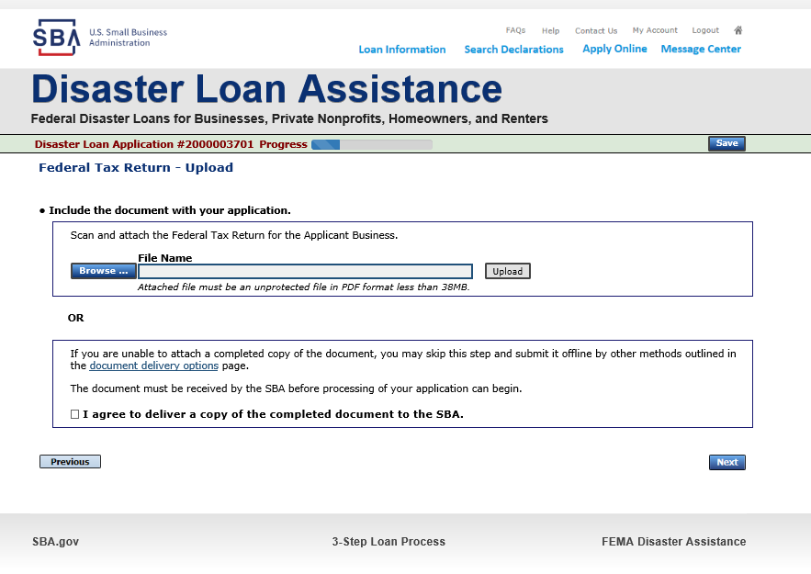
Tax Returns
To complete your application you must upload your most recent tax returns.
Taxes would be scanned and saved on the desktop. You would browse your desktop and then upload the tax returns.

Slide 37
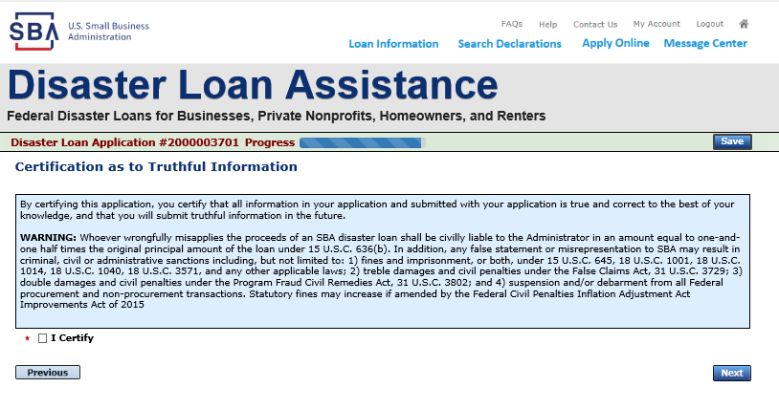
Certificate as to Truthful Information

Slide 38
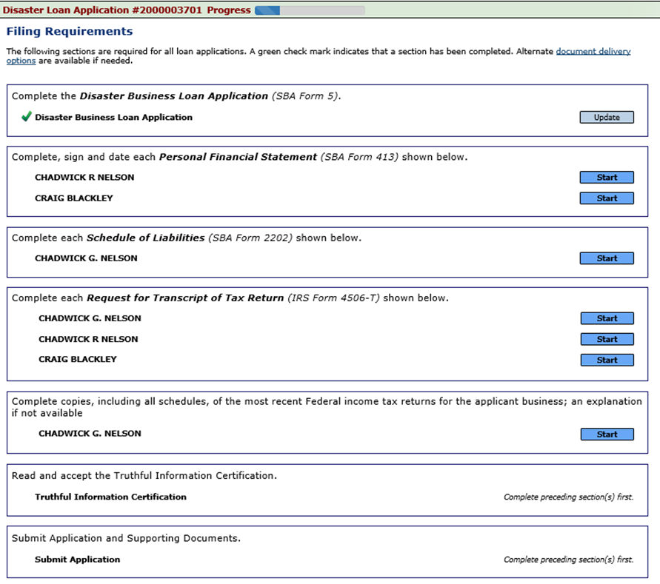
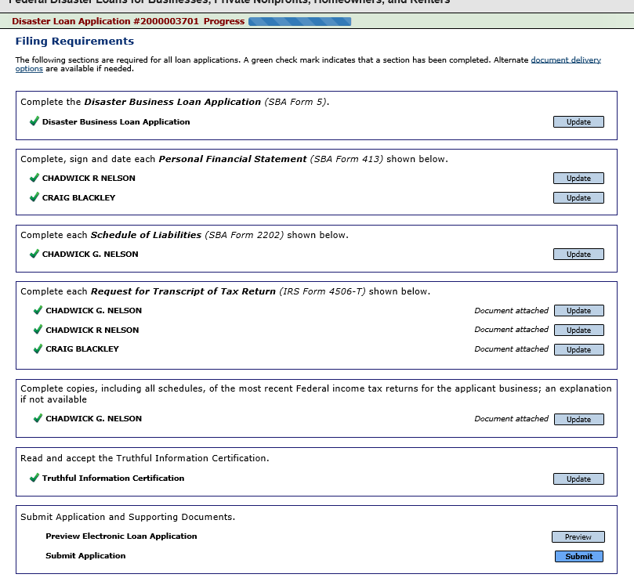
Filing Requirements Complete
You can see that all filing requirements no longer say “start” what shows now is all filing requirements have been updated and the application is ready to submit

Slide 39
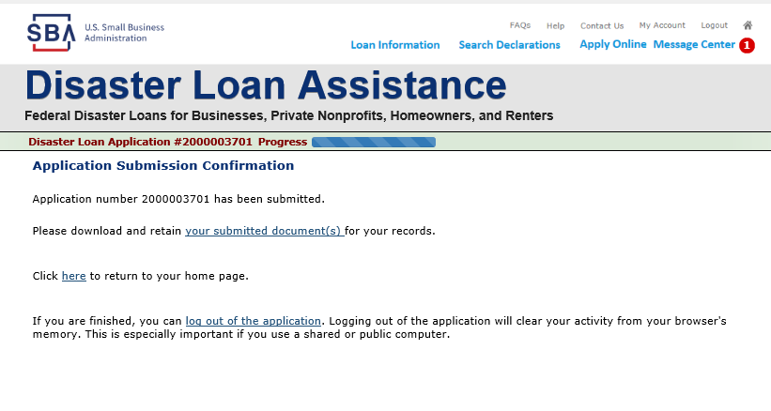
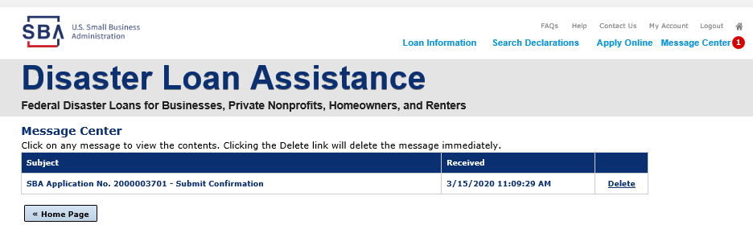
Application Successfully Submitted
Once the application is successfully submitted you will get this page. In the right hand corner a message indicator will appear. The message confirms submittal of the application

Slide 40
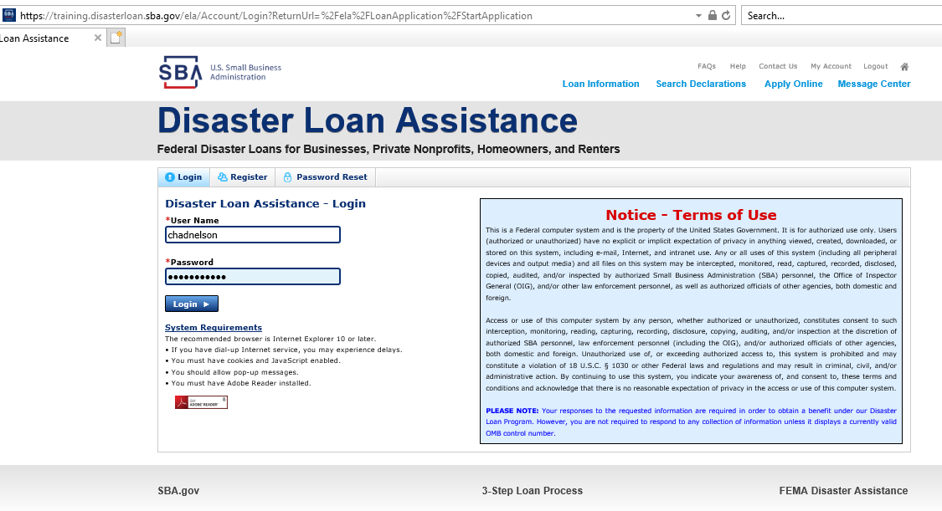
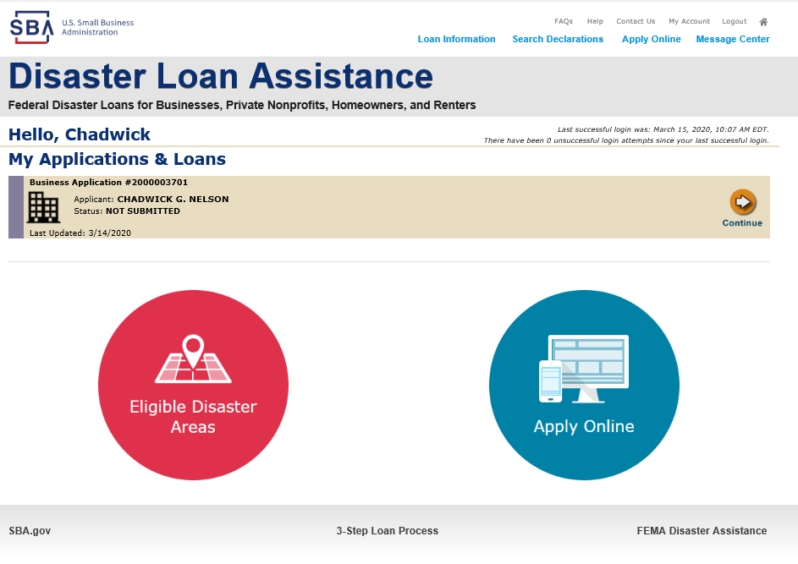
Returning to Complete Application
Input your user-name and password to complete a started application, once in click on “Continue”

Slide 41
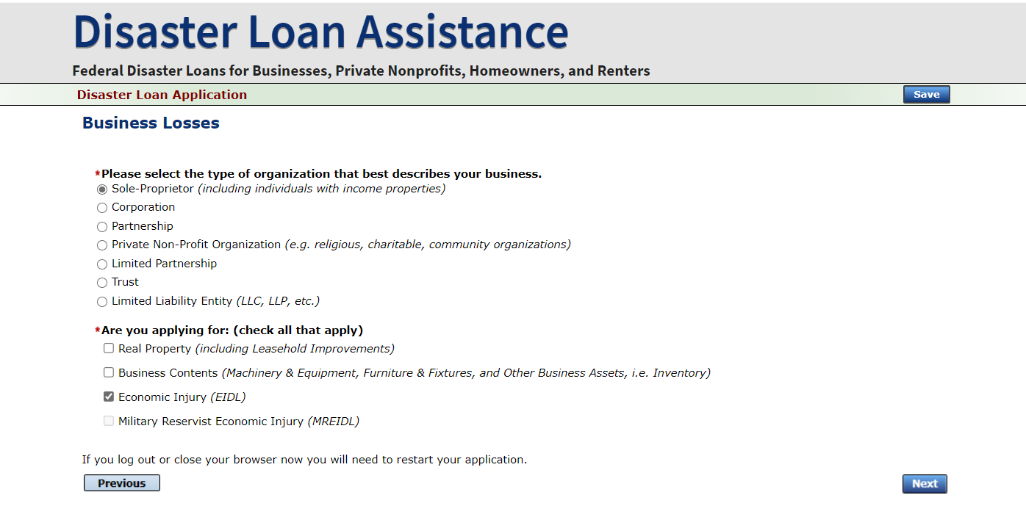
Business Losses
A Sole-Proprietor will use “Sole-Proprietor” and “Economic Injury (EIDL).

Slide 42
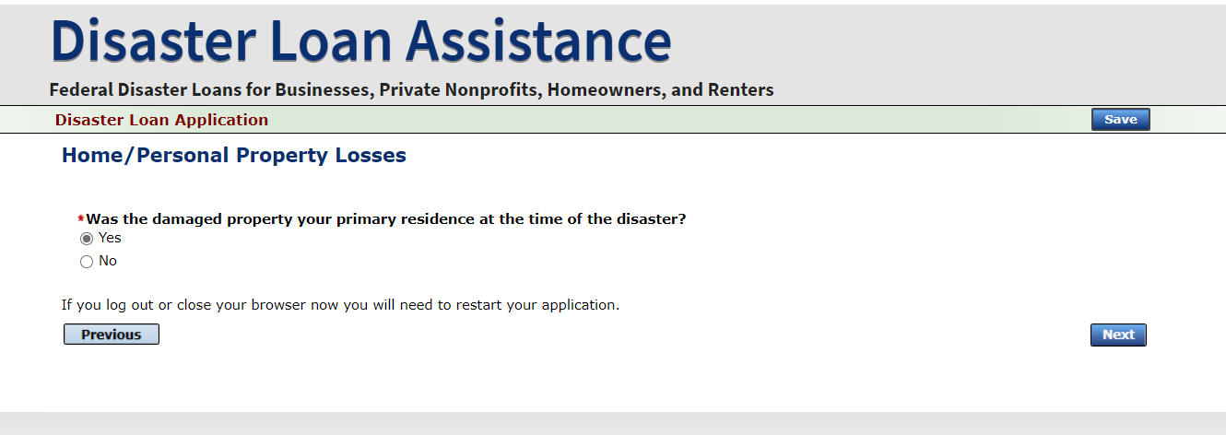
Home/Personal Losses
The Loan Application will walk you though the process. Click “Save” to save the input and click “Next” to navigate to the next page.

Slide 43
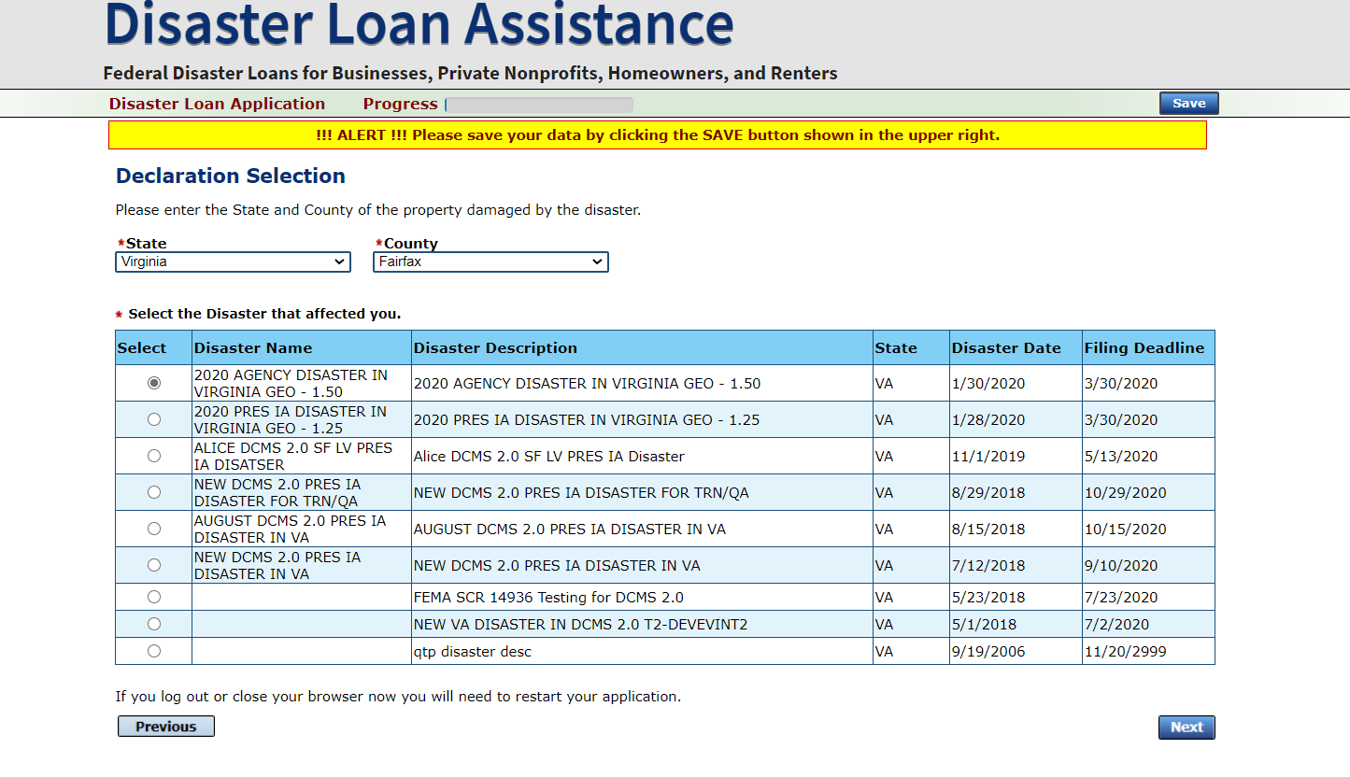
Declaration Selection
On the same line as the “Save” icon you also can see the “Progress” of the Disaster Loan Application.
Enter your “State” and “County”

Slide 44
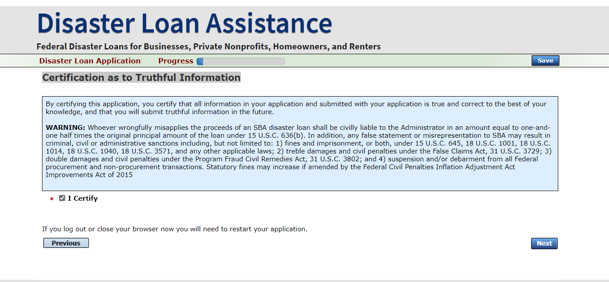
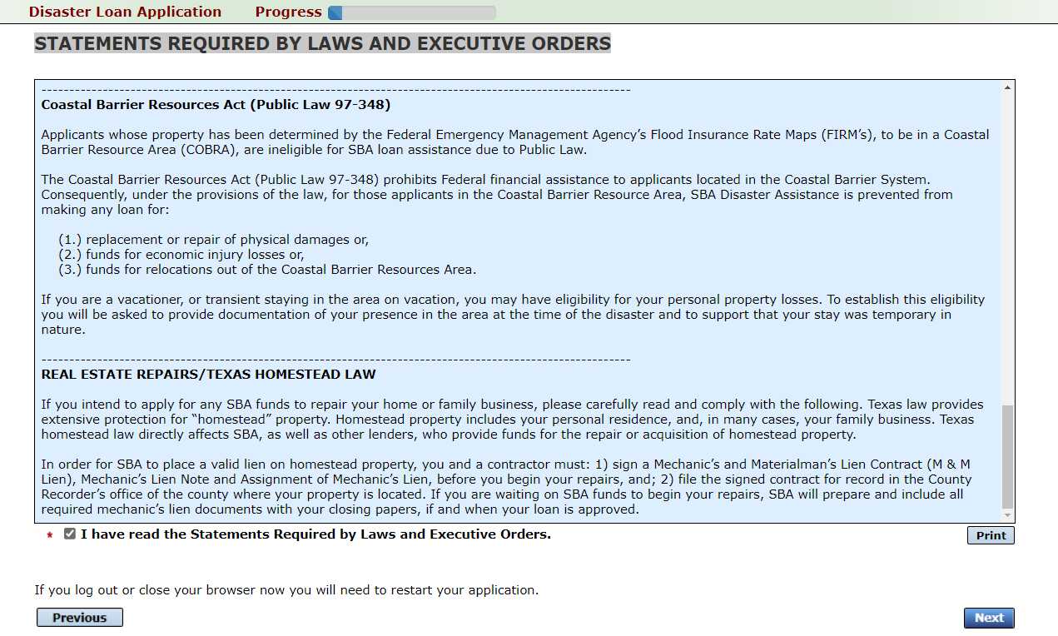
Certification and Executive Order
Read the “Warning”, check “I Certify” then click “Next”.
Read the information, check “I have read…” then click “Next”.

Slide 45
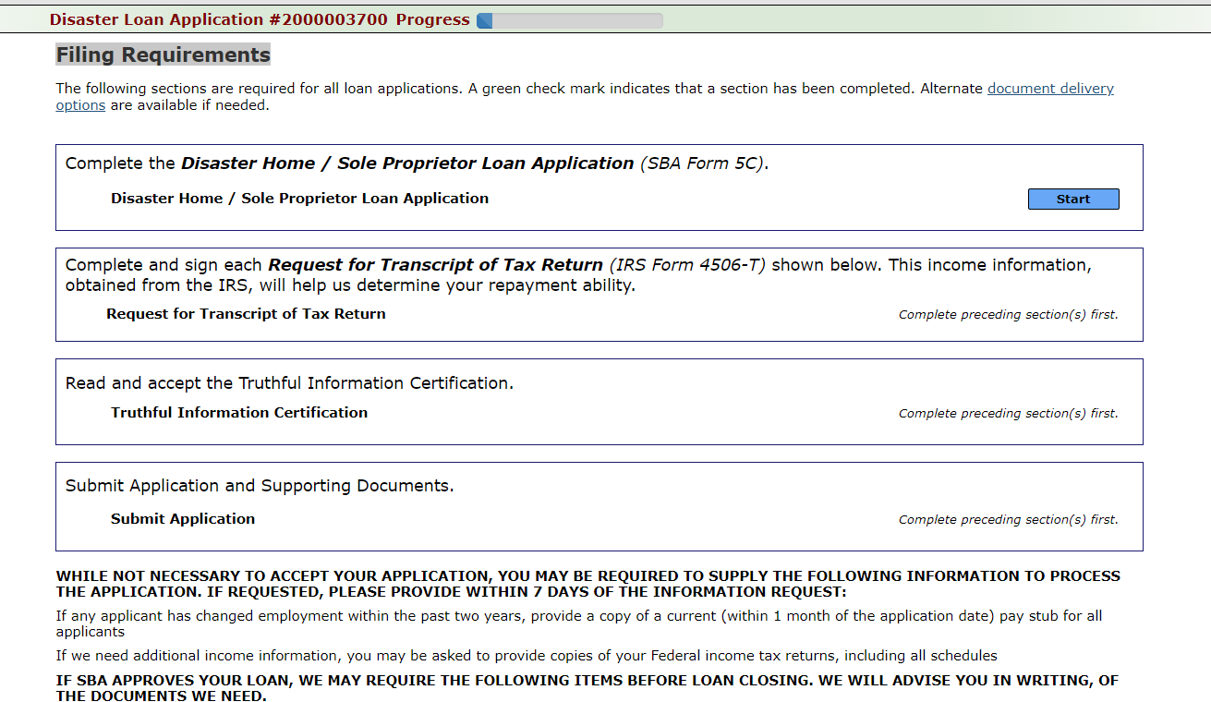
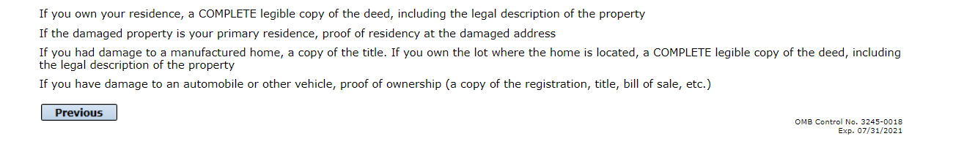
Filing Requirements
To continue with the application process click “Start” to complete SBA Form 5C.

Slide 46
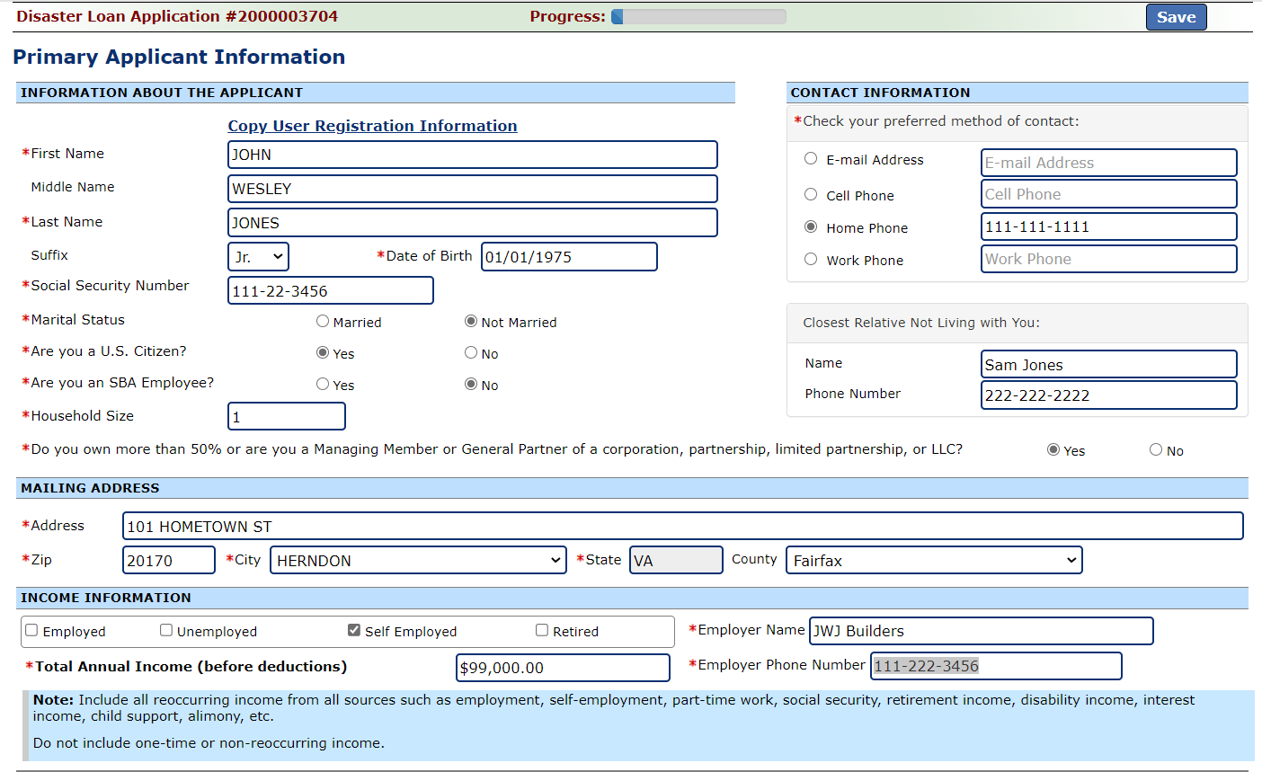
Completing Form 5C - Sole Proprietor Loan Application
Fill in the information blocks and then hit next. Fields marked with a red asterisk is a required field.

Slide 47
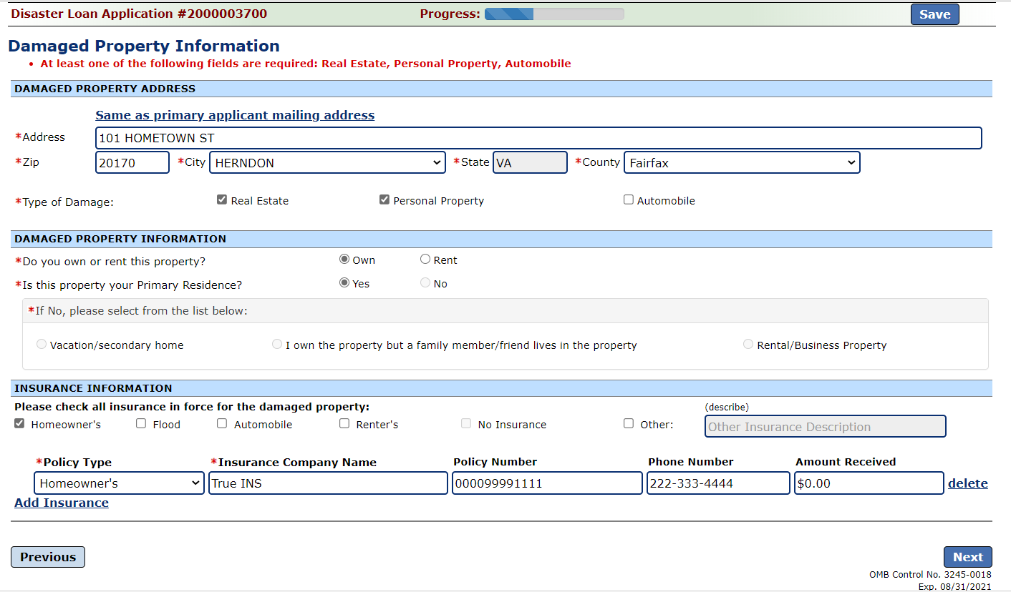
Form 5C continued - Damaged Property Information
Fill in the information blocks and then hit next. Fields marked with a red asterisk is a required field.

Slide 48


Form 5C continued -Debts and Assets Information
Fill in the information blocks and then hit next. Fields marked with a red asterisk is a required field.

Slide 49

Form 5C continued - Disclosure Statements
Fill in the information as required and then hit next.
Fields marked with a red asterisk is a required field.

Slide 50


Form 5C continued - Consent and Additional Comments
Read the information, check “All the information…” then click “Next”.
Additional Comments are used for clarifying or additional information.
Click “Next” to continue the process.

Slide 51

Form 5C continued - Affiliated Businesses
Fill out the Affiliated Business information then click “Save”.
To continue the process click “Next”.

Slide 52

Completing IRS Form 4506-T
Once you have finished the SBA Form 5C, the tax transcript information will need to be completed.

Slide 53

Request for Transcript of Tax Return
Form 4506T can be submitted electronically, via upload or offline. If the eSign option populates click through the options until the document is successfully completed. If you upload the document you would save it on your desktop, select browse and then upload.

Slide 54


Request for Transcript of Tax Return - Download / Upload
If you chose to deliver a copy this alert will appear. And you will no longer be able to upload information. The document will have to be submitted offline.

Slide 55


Request for Transcript of Tax Return - Download / Upload
Successfully Uploaded will appear when finished.
Then click “Next” to continue the process.
Once you have downloaded your tax returns you can upload.

Slide 56


Filing Requirements
Once the tax returns are complete sign the final Truthful Information Statement.

Slide 57

Submit Application
Finally you can submit your application when the “Submit” icon appears.

Slide 58

Application Submission Confirmation
After submission you will see that your application number has been submitted.

Slide 59

Message Center

Slide 60


Home Page
After competing application you automatically return to the home page.
From here you can check the status of your application by clicking the “Status” icon.

Slide 61

Application Status

Slide 62

Special Note
If you receive a message like the one below, depress “SAVE” so that you don’t lose your information.

